Slide 1
Near Earth Objects Predictions
12.20.2022
Pooja Mule
Anirudh Chintha
Teshwani Gogineni
Stevens Institute of Technology

Slide 2
Goal
The aim of this project is to predict whether an object passing in the vicinity of the earth should be treated as hazardous based on the dataset provided

Slide 3
Approach
Data Analysis
Data Processing & Handling Outliers
Model Selection
Principal Component Analysis
Optimizations based on previous results

Slide 4
Data Analysis
Pair plots were drawn to understand relationships between pairs of features and their patterns.
Following columns were dropped since either they have constant values or values that do not add much significance to the predictions - id, name, sentry object, and orbiting body.
After analyzing pairplots of remaining features with relative velocity, it was understood that relative velocity would not help yield the best predictions since it was not clearly differentiated from other features. So we have not used that feature.
After analyzing all the features, following features were utilized to train the model - est_diameter_min, est_diameter_max, miss_distance, and absolute_magnitude

Slide 5
Data Processing & Handling Outliers
Before examining the outliers, z-score normalization is performed to help with scaling.
At first, before removing outliers, we tried to replace them using different methods such as percentile and median.
But since it was observed that removing the outliers helped yield better predictions, it was decided to drop outliers from the dataset.
We removed the extreme 0.05% records from both sides. Around 2.94% of the total records (approx 90000) was classified as outliers.

Slide 6
Model Selection
After analyzing the data it was understood that the structure of data is non-linear.
The Support Vector Machine model would perform well in this case since it uses kernel tricks to perform more efficiently. Hence, the SVM model is picked for the purpose of these predictions.
After doing grid search and providing the C and gamma values, it was found that predictions did not change after tuning these parameters with the model.

Slide 7
Principal Component Analysis
The top 2 components returned by PCA are miss distance and absolute magnitude.
The model predictions remained the same after performing PCA.

Slide 8
Optimizations
When we downsampled, the prediction of the case False Positive (Model predicted object is hazardous but it actually is not) increased from 0.2% to 11%. But the case of True Negative (Model predicted object is not hazardous but it actually is) reduced dramatically from 7% to 0.1%.
In our case, recall is important than precision for true hazardous classifications as False Negatives are costlier than False Positives.
So the downsampling actually is better since we do not want to falsely predict that object is not hazardous when it actually is.

Slide 9
Different Model Predictions
Model | # Features | Precision |  | Recall |  | F1 Score |  | Support |  | C | Gamma
 |  | TRUE | FALSE | TRUE | FALSE | TRUE | FALSE | TRUE | FALSE
GridSearchCV | 4 | 0.92 | 0.85 | 1 | 0.14 | 0.96 | 0.24 | 16329 | 1668 | NA | NA
SVC | 4 | 0.92 | 0.85 | 1 | 0.14 | 0.96 | 0.24 | 16329 | 1668 | 100 | 1
GridSearchCV with PCA | 2 | 0.92 | 0.85 | 1 | 0.14 | 0.96 | 0.24 | 16329 | 1668 | NA | NA
SVC with PCA | 2 | 0.92 | 0.85 | 1 | 0.14 | 0.96 | 0.24 | 16329 | 1668 | 100 | 1
SVC with PCA and downsampling | 2 | 0.99 | 0.83 | 0.75 | 1 | 0.86 | 0.9 | 1567 | 1879 | 100 | 1

Slide 10
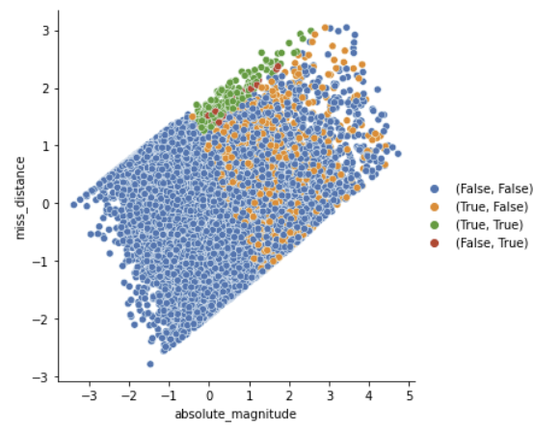
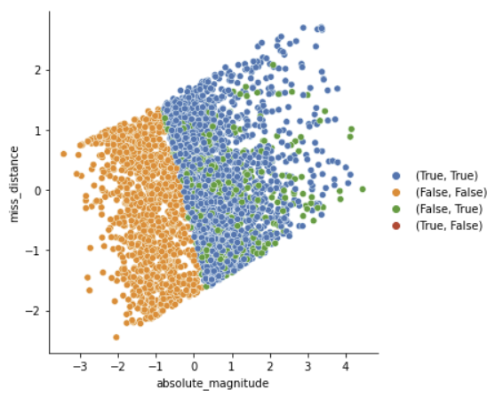
Relative Plots for before and after downsampling
Note: The points are (Actual, Prediction).

Slide 11
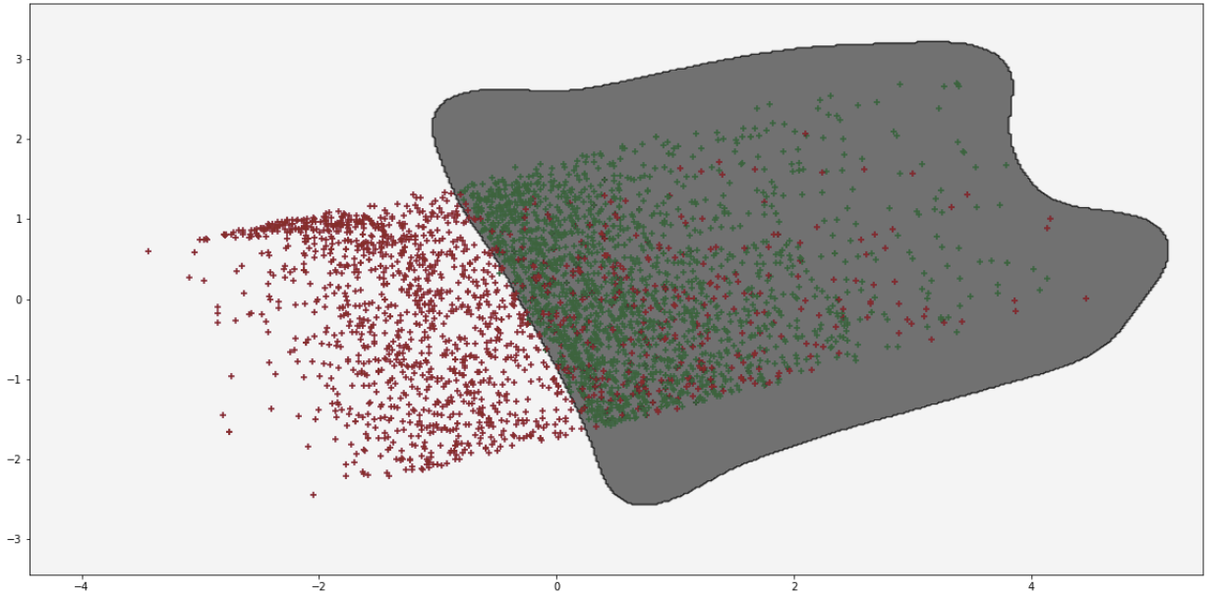
Boundary Decision Plot after Downsampling

Slide 12
Thank you!

